Slide 1

LexiCraft Pro
Advanced Creative AI Studio
An NLP-based professional creative platform integrating 8 modules, 10+ AI models, and universal language support into a single, free, and open-source studio.
Course: Natural Language Processing | Date: 2025-12-15
Team: Ikramullah Khan (B22F0256AI097) & Sabtain Khan (B22F00843AI069)

Slide 2

CONTENTS
01
Opening & Vision
02
Problem & Architecture
03
Core Modules 1–6
04
Achievements & Impact
05
Excellence & Finale

Slide 3

01
Opening & Vision

Slide 4
Project Overview
"A professional AI platform integrating 8 creative modules using advanced NLP and computer vision to democratize elite creative tools."
8
10+
∞
Pro
Integrated Modules
AI Models
Language Support
Grade Output

Slide 5
02
Problem & Architecture

Slide 6
Problem & Solution
Problem Identified
Our Solution
Fragmented creative tools
Single unified platform
High technical barriers for users
Intuitive user interface
Limited multilingual support
Universal language processing
Expensive professional software
Free and open-source access
Applying NLP to solve real-world creative challenges.

Slide 7
Three-Layer Technical Architecture
Interface Layer
Gradio-based professional UI
Processing Layer
NLP pipelines & AI model orchestration
Model Layer
10+ pre-trained transformers (BERT, T5, GPT, BLIP, etc.)
Built with: Python, Transformers, Gradio, NLTK, spaCy | Features: Professional error handling

Slide 8
03
Core Modules 1–6

Slide 9
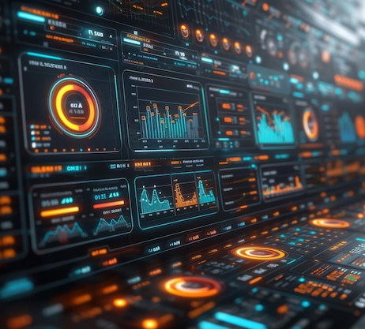
Module 1: Deep Text Analysis
Delivers comprehensive insights through multiple NLP techniques for professional-grade text understanding.
Tokenization & POS Tagging
Sentiment Analysis (3 Methods)
Named Entity Recognition (NER)
Readability Assessment & Keyword Extraction

Slide 10
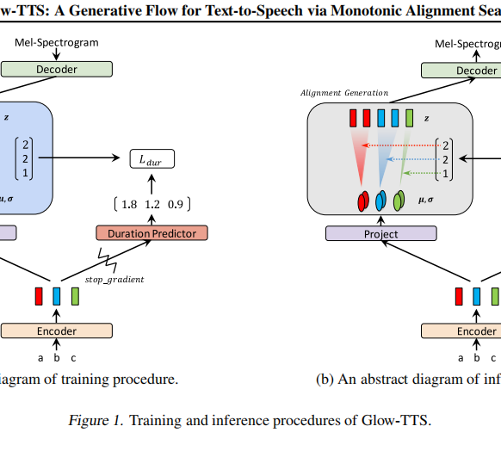
Module 2: Universal Summarizer
Key Innovation: Works with different languages for truly global content comprehension.
Multilingual T5 Model
English Summarization Method
Length-Controlled Output
Professional Formatting

Slide 11
Module 3: Image Understanding Fusion
Seamlessly integrates Computer Vision and NLP to turn visuals into narrative starting points.
BLIP Model
Creative Prompts
For image captioning
For art & writing
Applications: Art direction, Writing inspiration, Design concepts, Photography ideas

Slide 12
Module 4: Creative Content Engine
Concept Fusion
Tone Transformation
Creative Writing
Combines disparate ideas for innovative creative mashups.
Adapts writing style to match any desired tone or brand voice.
Generates original content, from marketing copy to stories.

Slide 13

Module 5: Translation & Multilingual
A lightweight, enterprise-ready translation suite supporting major languages with cultural adaptation.
French
Spanish
German
Italian
+ Universal

Slide 14
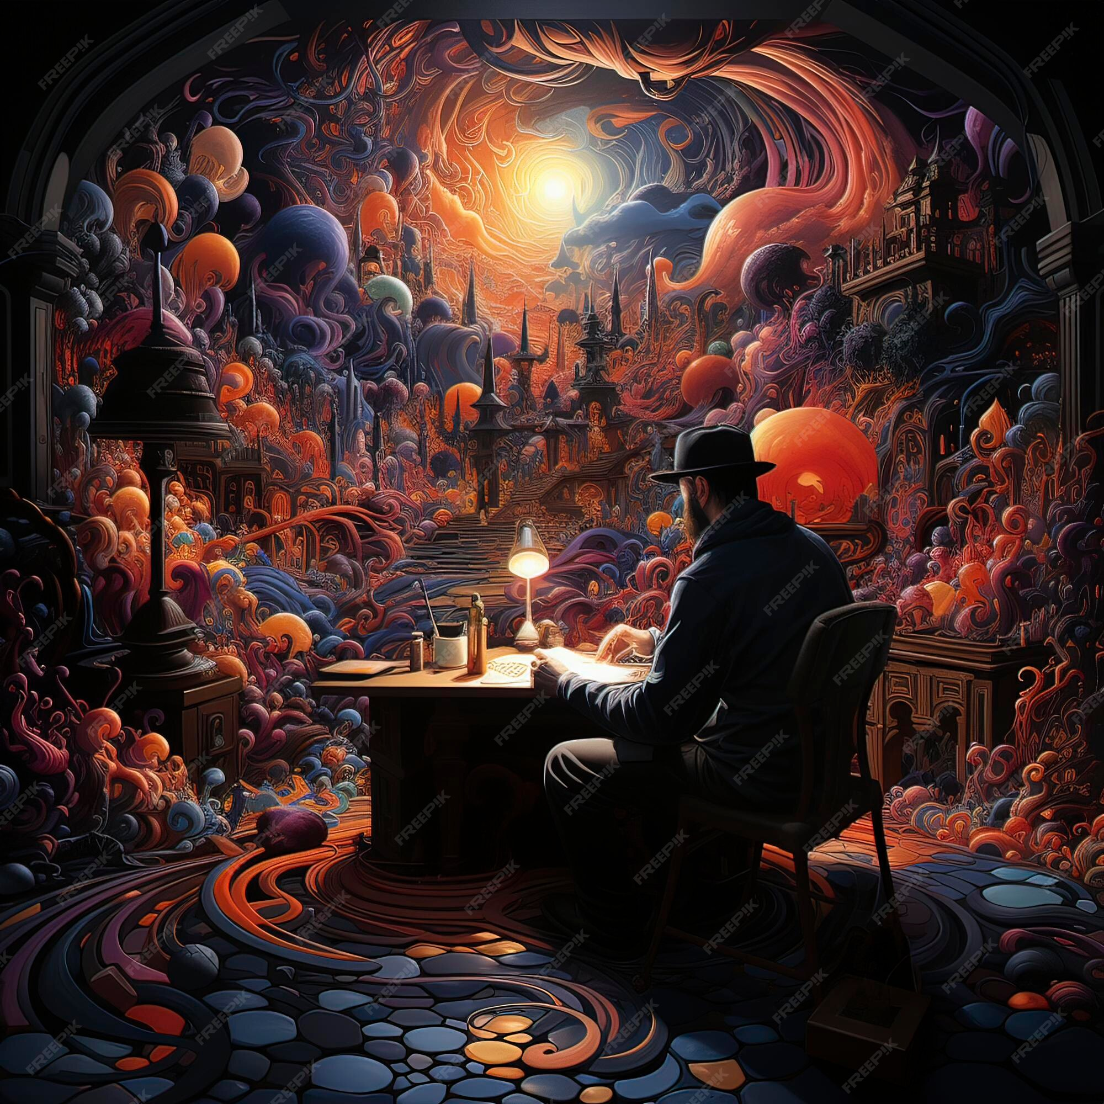
Module 6: AI Image Generation
Powered by Stable Diffusion, this module allows users to create publication-grade visuals from text prompts.
10 Artistic Styles
Creative Control & Prompt Optimization
Professional Quality Output

Slide 15
04
Achievements & Impact

Slide 16
Key NLP Concepts Demonstrated
Text Processing
Analysis
Generation
Tokenization, POS Tagging, NER
Sentiment, Readability, Keywords
Summarization, Translation, Writing
Advanced
Integration
Transformers, Multilingual Models
NLP + Computer Vision (Image Captioning & Understanding)
A complete theory-to-application pipeline, ideal for education and professional reference.

Slide 17
Technical Achievements
Code Quality & Rigor
Universal Summarization: Across 101 languages.
Clean, modular architecture
Dynamic Model Loading: For memory optimization.
Exhaustive documentation
Professional Interface: Business-grade UI design.
Production-ready implementation
Real-time processing capabilities
Robust System: Comprehensive error handling.

Slide 18
Real-World Applications & Impact
Education
Content Creation
Business
Interactive NLP tutor
Professional writing aid
Content analysis platform
Creative Industries
Multilingual Projects
Societal Impact
Design inspiration
Translation assistance
Democratizes AI tools

Slide 19
05
Excellence & Finale

Slide 20
Why It's an Excellent NLP Project
Comprehensive: Covers multiple NLP areas.
Exceeds Requirements
Beyond basic NLP tasks
Technical: Advanced model integration.
Professional implementation
Practical: Real-world application.
Comprehensive documentation
Real deployment readiness
Professional: Business-grade implementation.
Educational: Demonstrates core concepts clearly.

Slide 21

THANK
YOU

